Slide 1

RoomRover - Smart IoT Based Navigation
Team Members:
Chinmay Sawant – 22106017
Arya Raut – 22106075
Gauri Ramekar – 22106068
Maitreyi Phadke – 221060
Guide: Prof. Sayali Badhan
Dept. of CSE (AI & ML)
Academic Year: 2025–26

Slide 2
Outline
Introduction
Literature Survey
Limitations of Existing Systems
Problem Statement & Objectives
Proposed System & Design
Tools and Technologies
Implementation (Demo Video + Screenshots)
Experimental Setup
Expected Outcomes
Goal Alignment (UN SDGs)
Conclusion & Future Work
References

Slide 3
Introduction
Large institutions such as universities, hospitals, and corporate buildings often have complex layouts, making it challenging for visitors and even staff to find their way efficiently. Traditional navigation aids like maps, signboards, or mobile apps often fall short, especially in crowded or dynamic environments, leading to confusion, delays, and sometimes safety risks. This challenge motivated us to design a smart system that combines efficient guidance with real-time safety monitoring, providing users with a seamless and secure navigation experience within large facilities..

Slide 4
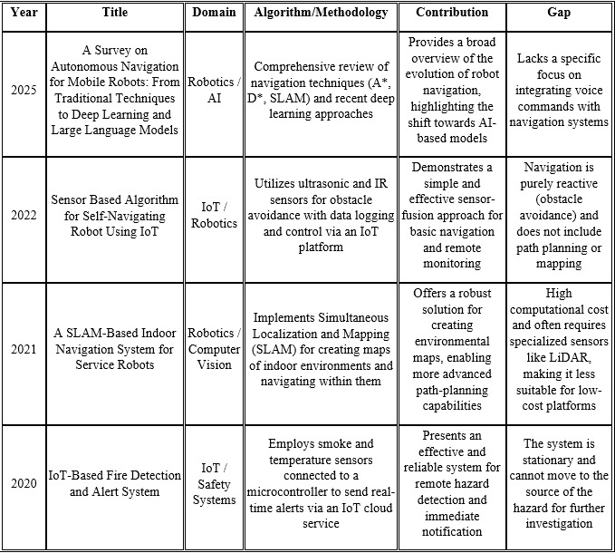
Literature Survey

Slide 5
Limitations of Existing Systems
Limited or no real-time emergency response.
High cost of deployment.
Lack of adaptability in dynamic indoor spaces.
Amazon Astro – Works as a smart home companion but lacks emergency response features (no smoke detection or SOS).
TurtleBot – Excellent for research and prototyping, but not designed for user-friendly, real-world navigation.

Slide 6
Problem Statement
In large indoor environments such as colleges, hospitals, and corporate offices, visitors and even staff often face difficulties navigating complex layouts and locating specific rooms or departments. Traditional solutions like maps, signboards, or mobile apps are often insufficient, especially in crowded or dynamic situations. Moreover, during emergencies such as fires, medical incidents, or other hazards, immediate guidance and assistance are usually unavailable, putting users at risk. There is a need for an intelligent indoor robotic system that can guide users and provide real-time emergency support, ensuring both convenience and safety in a single platform.

Slide 7
Objectives
To develop a smart indoor robot capable of navigation and assistance .
To enable voice-based interaction for easier communication
with users.
To respond to emergencies by detecting smoke and fire.
To create a system that is adaptive, intelligent, and user-
friendly, enhancing the experience of navigating large buildings

Slide 8
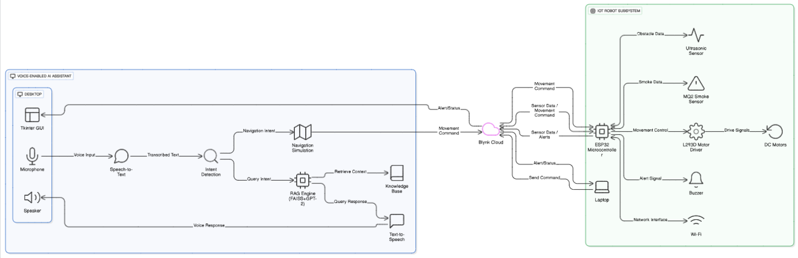
Proposed System

Slide 9
Tools & Technologies
Category | Tools | Purpose
Microcontroller & Hardware | ESP32 | Main controller: motors, sensors, Wi-Fi connectivity, Blynk integration
 | L298N Motor Driver | Controls left and right DC motors
 | DC Motors (4x) | Wheel movement for robot
 | HC-SR04 Ultrasonic Sensor | Obstacle detection, distance measurement
 | MQ2 Gas Sensor | Smoke / gas detection
 | Buzzer | Alert for gas/fire detection
 | Battery (6–12V) | Power source for motors and ESP32
 | Breadboard & Jumper Wires | Connections and prototyping
 | Technologies
Software & IDEs | Arduino IDE | Writing and uploading ESP32 code
 | Python | Speech recognition, fire detection, email/SMS alerts
 | Visual Studio Code | Python development
Libraries / SDKs | Blynk ESP32 SDK | ESP32 connects and reads/writes to Blynk Realtime Database
 | Python Blynk SDK / HTTP API | Python scripts send commands and alerts to Blynk DB
 | SpeechRecognition | Converts microphone input to text
 | PyAudio | Microphone input for speech recognition
 | smtplib & email.mime | Sending email alerts for fire/smoke detection
 | OpenCV & gTTS | Camera-based fire detection & audio alerts
Cloud / Database | Blynk Realtime Database | Stores sensor readings, robot status, commands, alerts

Slide 10
Implementation

Slide 11
Experimental Setup

Slide 12
Expected Outcomes
Robot guides users indoors.
Responds to voice queries instantly.
Detects smoke/fire and sends real-time alerts.
Affordable, scalable solution for smart campuses & hospitals.

Slide 13
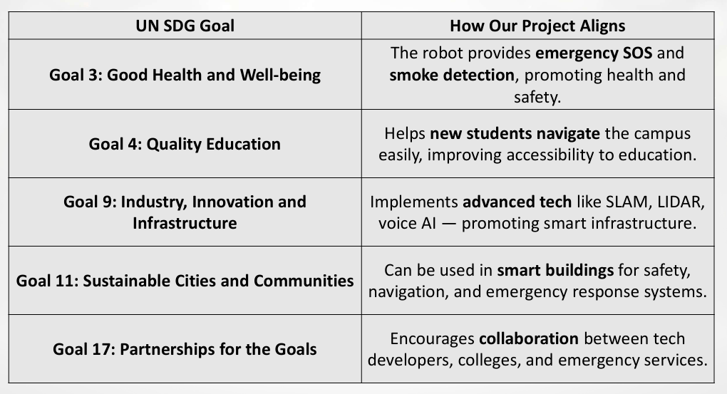
Goal Alignment (UN SDGs)

Slide 14
Conclusion
The review of existing systems shows that while some focus on navigation and others on safety, none provide a unified, affordable solution suitable for large institutions. Room Rover addresses this gap by integrating indoor navigation with IoT-enabled emergency support in a single platform. It ensures that users can easily find their destinations through simple voice interaction while also being protected by real-time smoke detection and SOS alerts. By combining navigation, communication, and emergency preparedness, Room Rover not only improves convenience and accessibility but also builds a safer and more efficient environment for universities, hospitals, and corporate buildings.

Slide 15
References
Amazon Astro – https://www.amazon.com/Astro-Household-robot-for-home/dp/B094XD5ZW6
TurtleBot – https://www.turtlebot.com
"A Survey on Autonomous Navigation for Mobile Robots: From Traditional Techniques to Deep Learning and Large Language Models" (Robotics Journal, MDPI) Ying He, Xiang Li, et al. (2025).
"Sensor Based Algorithm for Self-Navigating Robot Using IoT" (International Journal of Advanced Computer Science and Applications – IJACSA) Ananya Sharma, Ravi Patel (2022).
"A SLAM-Based Indoor Navigation System for Service Robots" (IEEE) Chen Zhang, Li Wei, et al. (2021).
"IoT-Based Fire Detection and Alert System" (Springer) Priya R., Kumar S., et al. (2020)

Slide 16
Thank You !!

